Slide 1
Procedurally Generated World Map With Distinct Biomes and Cultural Regions
Mark Flanagan
Honours Project 2021/22

Slide 2
Introduction
Background

Slide 3
What is Procedural Content Generation (PCG)?
The algorithmic generation of game content with limited or no human contribution (Togelius et al, 2013)
Game content – the elements within a game that the player interacts with (like the map), but not the game itself (engine, AI, game mechanics)
Algorithmic in nature, rooted in design. Every PCG system implicitly encodes a formal theory of the game design process (Smith, 2015)
Has both economic and design benefits

Slide 4
Procedural Map Generation
A pseudo-random process for defining a play-space
Often used in Rogue-likes (e.g. Rogue, Spelunky, Darkest Dungeon II) or sandbox games (Minecraft, Terraria) for online generation
Used in a variety of games (The Elder Scrolls IV: Oblivion, No Man’s Sky) for offline generation and more hand-tailored content (GameRant, 2022)(Morin, 2016)
Two types of map generation: Space Generation or System Generation (T Short, T Adams, 2017)
In games requiring system generation, the topography of the environment is important but does not define the player’s primary interactions with the world

Slide 5
The Problem with Randomising Maps
Generated regional points of interest (POIs) can fail to meet the expected naming conventions of their surroundings (e.g. “The Golden Coast” of ESIV: Oblivion is a green-grass field)
The general solution is to make generated areas mono-cultural, aka giving all POIs the same naming conventions, but this can make names appear generic, and fail to reflect the in-story cultures which inhabit that world
Can also inhibit the player’s ability to engage meaningfully with these alternate cultures
Other solutions (Azgaar’s Fantasy Map Generator, Hexographer) create multi-cultural worlds, but these cultures can appear in regions we would not expect from our own world (e.g. East-Asian-influenced cultures emerging in deserts or snowy regions, and directly beside Western-influenced regions)

Slide 6
Research Question
How can procedural content generation techniques be used to produce a world map with believable naming conventions for points of interest in distinct biomes?
A development type project with user testing
By combining multiple PCG methods in a meaningful way (name and map generation) at the algorithm level, this project aims to create a more complex, interesting piece of procedurally generated content

Slide 7
Demonstration
The Map generator

Slide 8
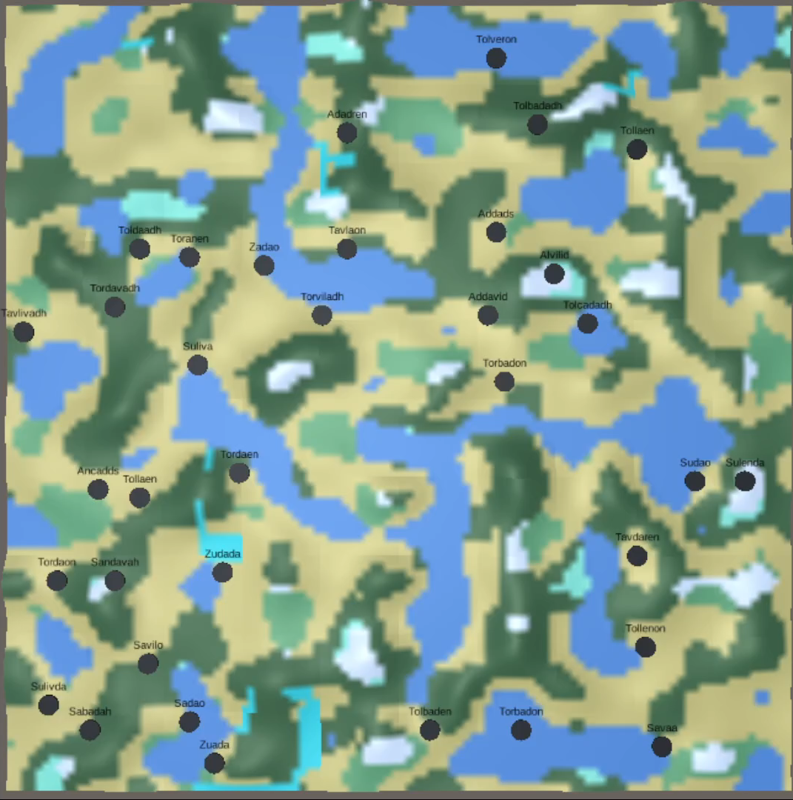
Map Generator
Each generation first generates terrain tiles, then applies Perlin noise waves to create a heightmap and apply it across the tiles to create the landscape
Then a heatmap is generated using a combination of a uniform heatmap and Perlin waves, and a moisture map from Perlin waves again.
These are combined using a Whittaker Biome Diagram (Whittaker, 1962) to create distinct biomes: tundra, desert, grassland, boreal forest, tropical rainforest and savanna. Water was in areas below a certain height threshold and were areas without a designated biome
Then rivers are generated by randomly selecting high points around the map and building downwards until reaching water
Cities are spawned by randomly selecting areas around the map, not in water and not too near other cities (a radius designated by developers), instantiating a city there and then using the biome data of that coordinate to select a name from the appropriate naming generator (each culture is separated into individual biomes)
This creates clusters of cities out of the water, loosely linked in naming convention to give the appearance of emergent countries
Available at https://simmer.io/@SwanDiveGames/honours-random-world-generation-w-cities-named-by-region

Slide 9
The Map Generator
How it works

Slide 10
Test Results
Method and findings

Slide 11
Conclusion
Final points, future work

Slide 12
References
Morin, R., 2016. Inside the Artificial Universe That Creates Itself. [online] The Atlantic. Available at: <https://www.theatlantic.com/technology/archive/2016/02/artificial-universe-no-mans-sky/463308/> [Accessed 26 April 2022].
Togelius, J., Champandard, A.J., Lanzi, P.L., Mateas, M., Paiva, A., Preuss, M. and Stanley, K.O., 2013. Procedural content generation: Goals, challenges and actionable steps. Schloss Dagstuhl-Leibniz-Zentrum fuer Informatik.
Smith, G., 2015, June. An Analog History of Procedural Content Generation. In FDG.

